Slide 1



DYNAMICS 365 BUSINESS CENTRAL (NAV)
Orlando, FL October 19-23, 2025

Slide 2
Unlocking the Power of Business Central with Power BI: Your First Extension

Slide 3







Jeff Landeen D365 BC Director RSM US LLP
Bennett Gackle D365 BC Supervisor RSM US LLP

Slide 4
Session Objectives
What will you learn today?
Understand how to expose any Business Central Data for PowerBI Reports
Learn how to connect PowerBI Desktop to Business Central and build a report
Know how to publish your own custom extension

Slide 5
Session Agenda
Focus on Business Central in the cloud​
Walkthrough a use case
Tools to Use and Install to Make the API Page Quickly and Easily​
Step by Step Instruction to Setting up Visual Studio and PowerBI for the first time​
Step by Step Instruction to Creating a basic API Page​
Connecting to the API Page Created
Construct a PowerBI Report

Slide 6
Why The Need For an API?
Web Services Exposure of Pages Deprecating
2027 Wave 1 Release (version 30.0)
Standard API’s Not Satisfying Data Needs
API’s to Accompany a Larger Extension

Slide 7
What Are We Building?
Our scenario:
Desire to Build a Sales Report
Identified our data sources in Business Central but standard API’s aren’t satisfying our needs
Our actions:
Construct an API
Connect to the API in PowerBI
Construct the Report in PowerBI

Slide 8
Tools Required
Microsoft Visual Studio Code​
PowerBI Desktop

Slide 9
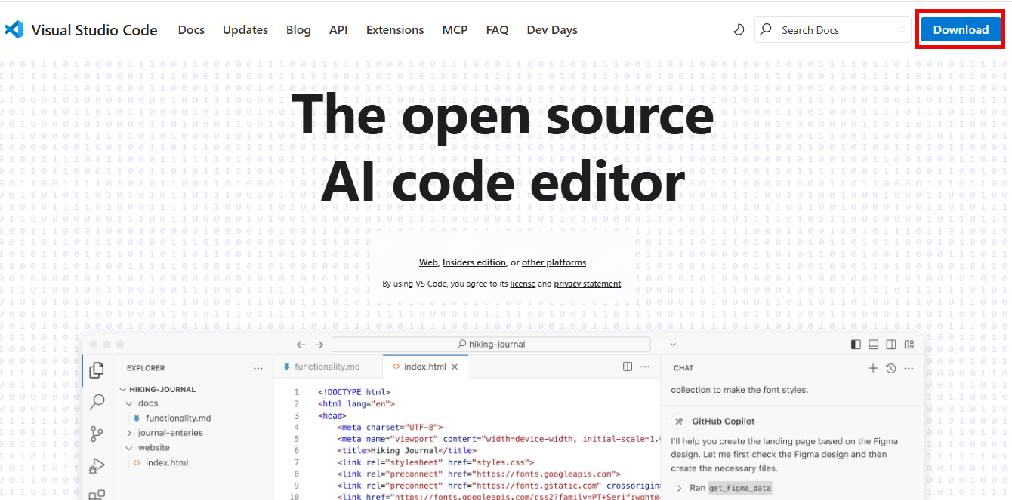
Downloading Visual Studio Code
Navigate to: https://code.visualstudio.com/

Slide 10
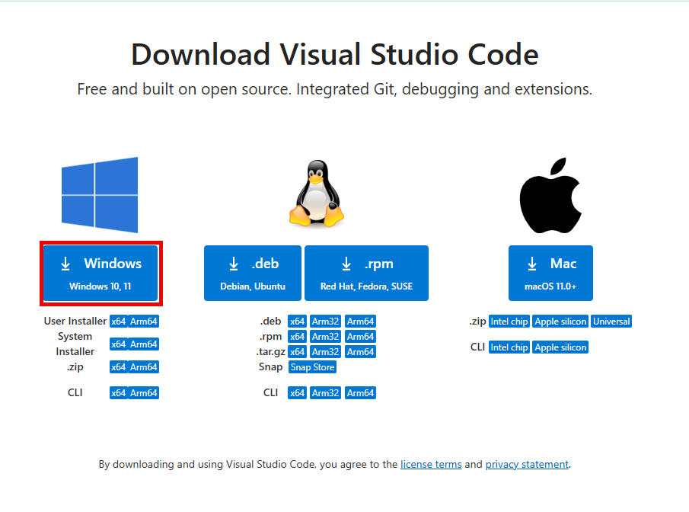
Downloading Visual Studio Code
Click on “Windows”
Notes:
Jamie

Slide 11
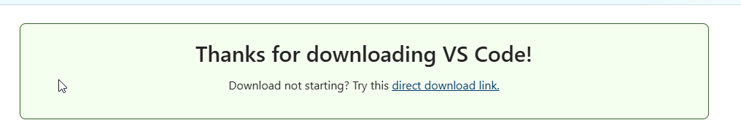
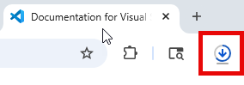
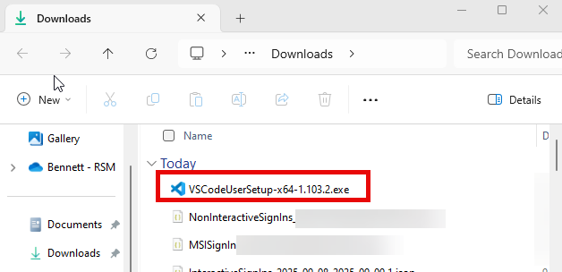
Downloading Visual Studio Code
A Download should display in the web browser’s download icon and present a download page. Open the .exe file once the download completes.
Notes:
Jamie

Slide 12
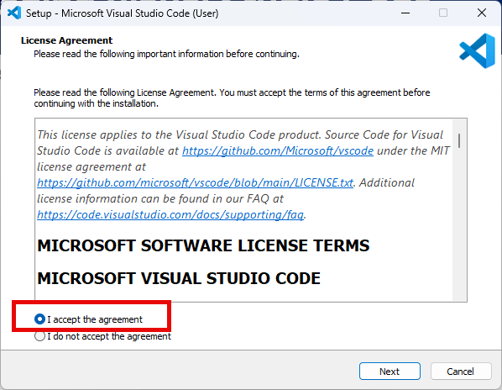
Downloading Visual Studio Code
Click on “I accept the agreement” and Click Next
Notes:
Jamie

Slide 13
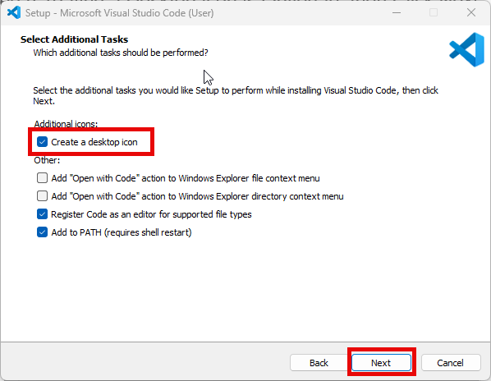
Downloading Visual Studio Code
Leave All Defaults Checked (Creating a Desktop Icon is Optional), then Click Next
Notes:
Jamie

Slide 14
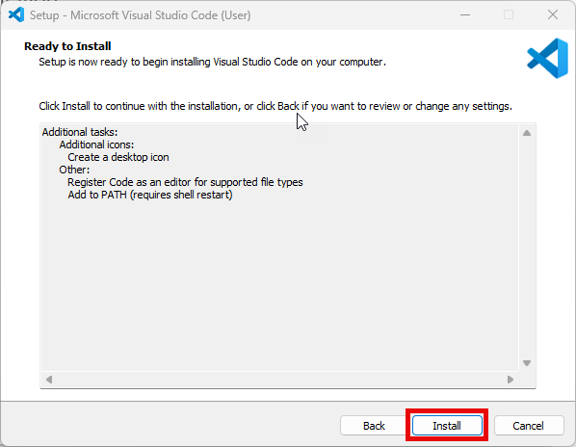
Downloading Visual Studio Code
Click Install to Begin Installation
Notes:
Jamie

Slide 15
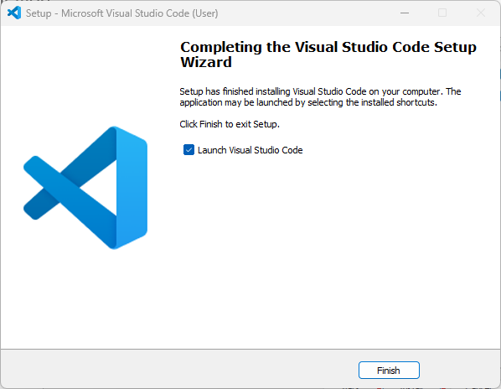
Downloading Visual Studio Code

Slide 16
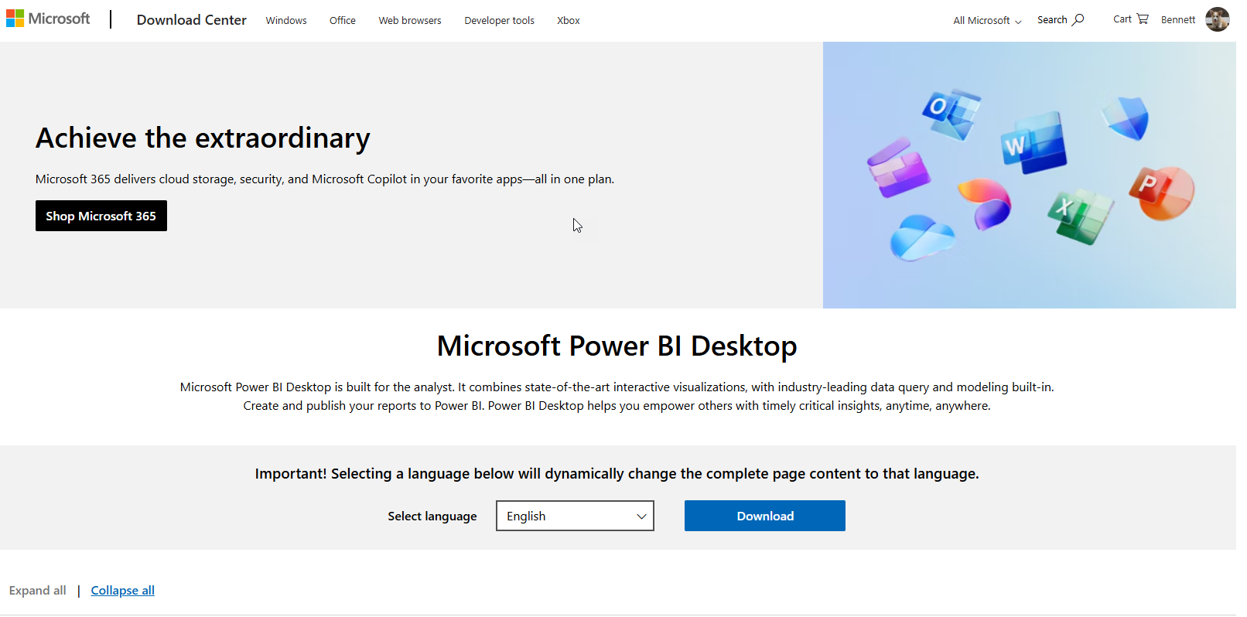
Downloading PowerBI Desktop
Navigate to: https://www.microsoft.com/en-us/download/details.aspx?id=58494
Notes:
Jamie

Slide 17
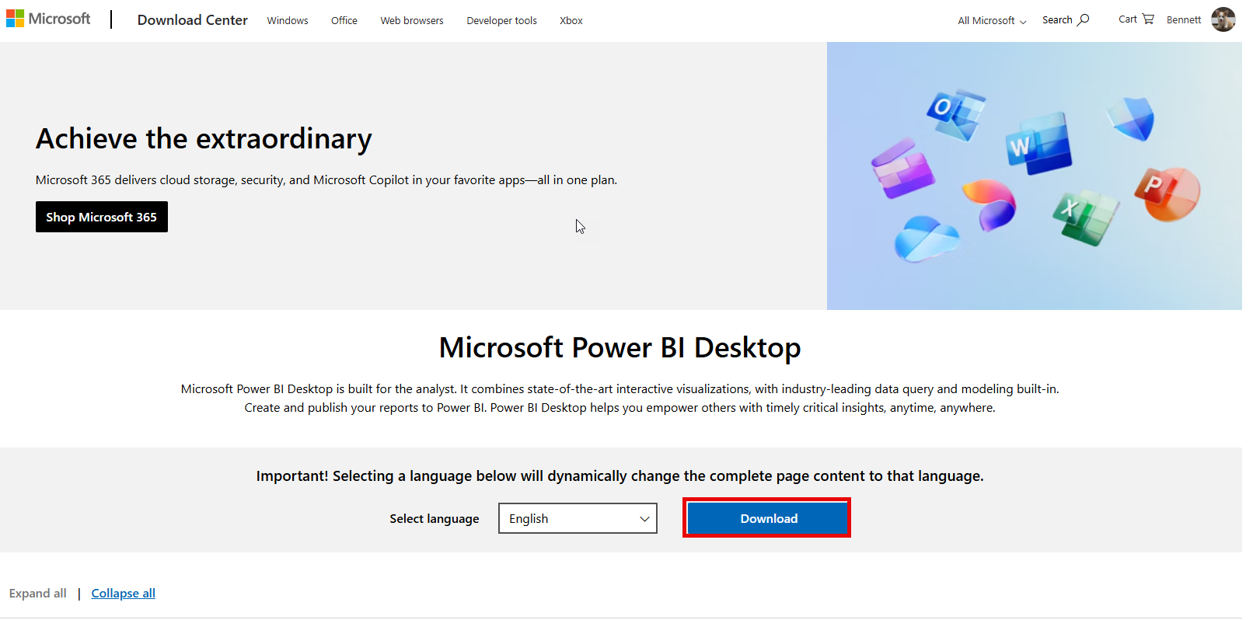
Downloading PowerBI Desktop
Click on Download
Notes:
Jamie

Slide 18
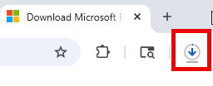
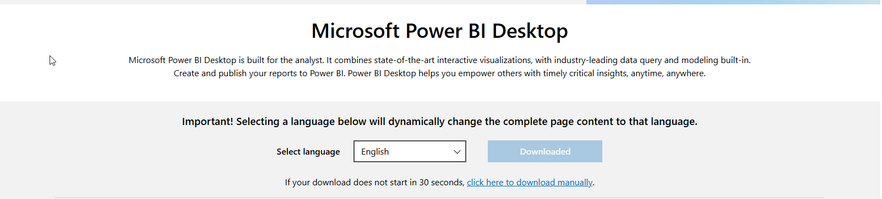
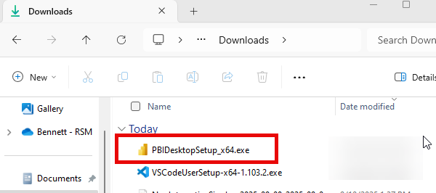
Downloading PowerBI Desktop
The download should trigger instantly and download the most recent version of PowerBI
Notes:
Jamie

Slide 19
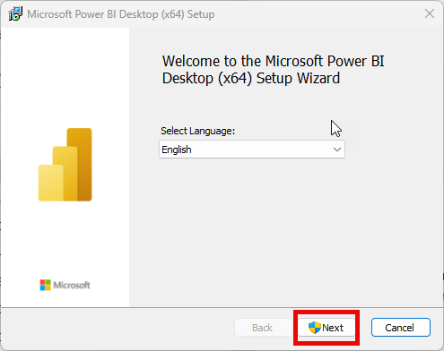
Downloading PowerBI Desktop
Click Next, you may have to grant your computer permission for the next step to take place
Notes:
Jamie

Slide 20
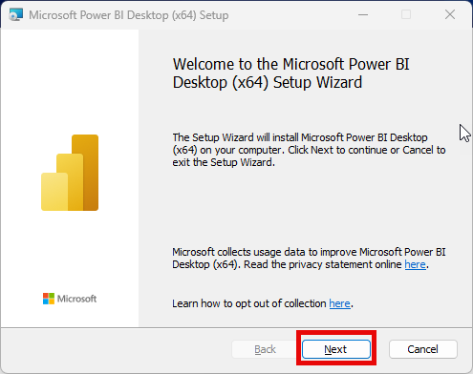
Downloading PowerBI Desktop
Click Next
Notes:
Jamie

Slide 21
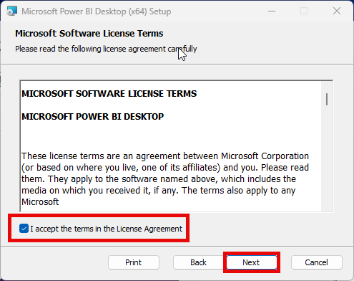
Downloading PowerBI Desktop
Click Check Mark to Accept License Agreement, then Click Next
Notes:
Jamie

Slide 22
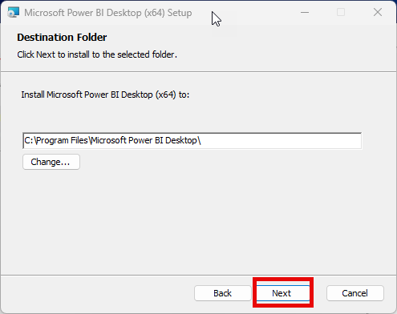
Downloading PowerBI Desktop
Allow for PowerBI to Install to Default Folder Path, then Click Next
Notes:
Jamie

Slide 23
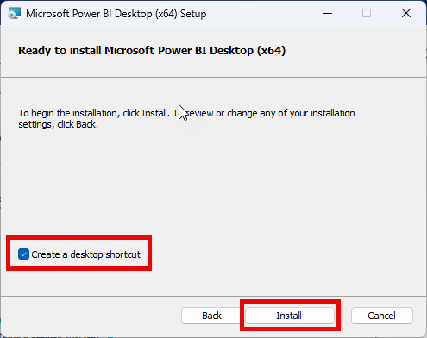
Downloading PowerBI Desktop
Allow for PowerBI to Create a Desktop Shortcut (optional), then Click Install
Notes:
Jamie

Slide 24
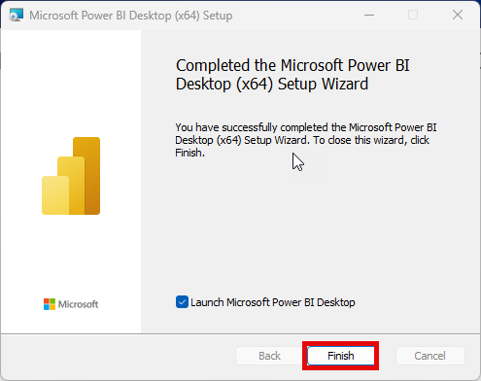
Downloading PowerBI Desktop
Launch PowerBI Desktop to Confirm Installation (optional), then Click Finish
Notes:
Jamie

Slide 25
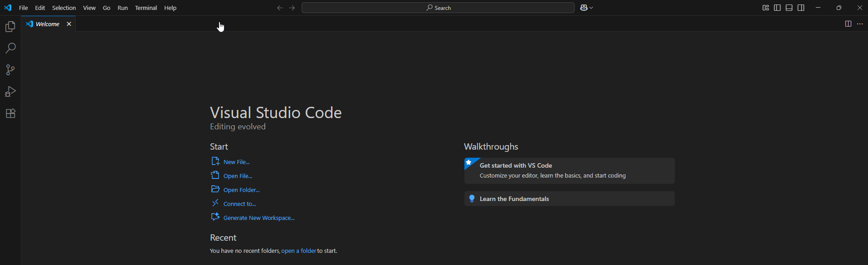
Configure VS Code 1st Time Use
Open Visual Studio Code
Notes:
Jamie

Slide 26
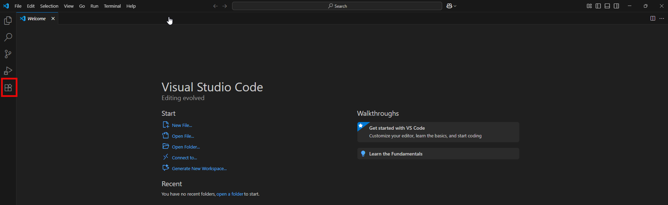
Configure VS Code 1st Time Use
Click on Extensions
Notes:
Jamie

Slide 27
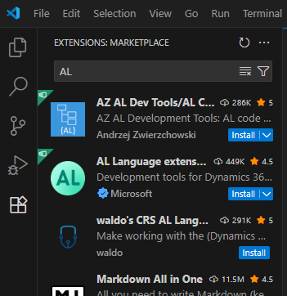
Configure VS Code 1st Time Use
In the Extensions Marketplace Search Bar, Type “AL”
Notes:
Jamie

Slide 28
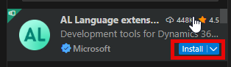
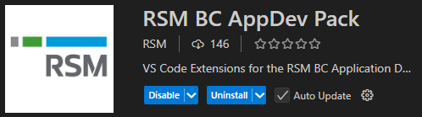
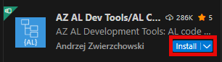
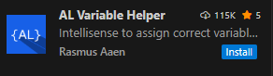
Configure VS Code 1st Time Use
Click on Install of AL Language extension by Microsoft (REQUIRED)
Search & Install RSM BC AppDev Pack
(includes a number of other tools)
Click Install on AZ AL Dev Tools/AL Code .. By Andrzej Zwierzchowski
Click on Install of AL Variable Helper extension by Rasmus Aaen
Notes:
Why install these extensions? This makes coding easier and can be time savers.

Slide 29
Preparing to Code (Key Shortcuts)
Ctrl+Shift+B = Compile the objects (will create place holder report layouts)​
Ctrl+Shift+P = Open command pallet ​
Can then select ‘AL:Go!’or ‘AL:Download Symbols’​
Alt+Shift+E = Open Event List​
Use this to insert Event subscribers into a codeunit​
F5 = Run with Debbuger​
Will compile your solution, publish it to server, hook up debugging session​
Ctrl+F5 = Run (no Debugger)​
Will compile your solution and publish to server (but will NOT hook up debugger)
Notes:
Jamie

Slide 30
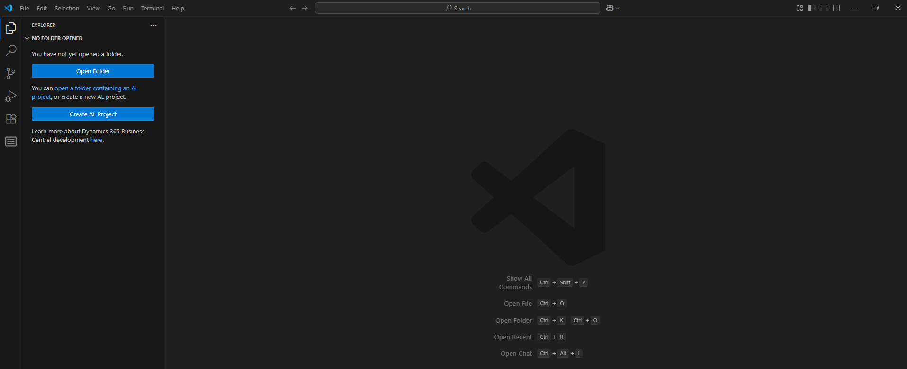
Preparing to Code
Hold Ctrl + Shift + P to Open the Command Prompt in VS Code. Type In or Select AL: Go!
Notes:
Jamie

Slide 31
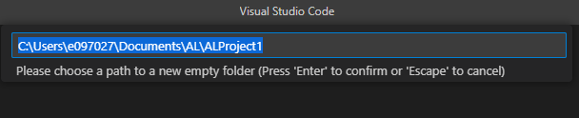
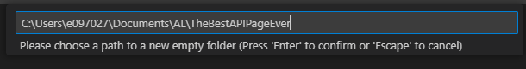
Preparing to Code
The Command Prompt Will Convert to a File Path.
Create a Folder for Your API Extension.
Whatever You Name This Folder Will Be the Name of the Extension Installed into BC.
Enter In the Folder Name You Wish to Use.
Notes:
Jamie

Slide 32
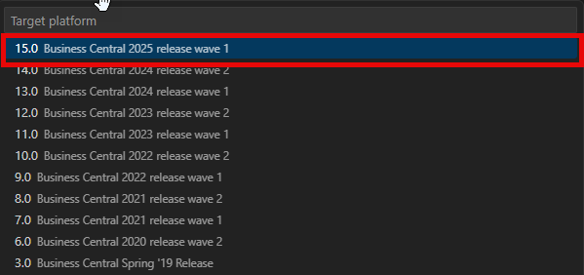
Preparing to Code
Select the Version of Business Central That You Will Be Preparing Code to. It is Best Practice to Always Select the Most Recent Version.
Notes:
Jamie

Slide 33
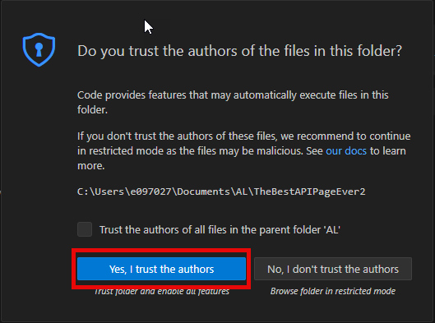
Preparing to Code
As You are the Author of the File, Select “Yes, I trust the authors”
Notes:
Jamie

Slide 34
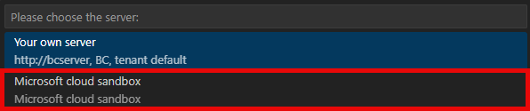
Preparing to Code
Choose Microsoft Cloud Sandbox as Most of Our Clients Have BC Hosted in the Cloud
Notes:
Jamie

Slide 35
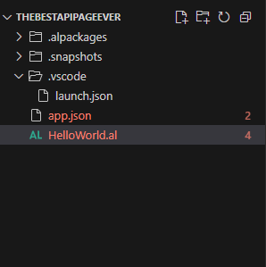
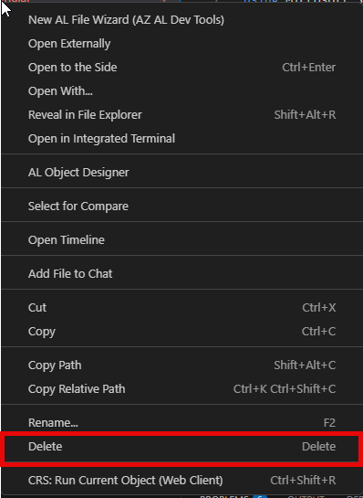
Preparing to Code
A Launch.json, an App.json, and a HelloWorld.al file will generate.
You May Delete the HelloWorld.al File as That’s a Placeholder.
We Will Generate Our .al Page for Our API Later.
To Delete, Simply Right-Click and Choose Delete.
Notes:
Jamie

Slide 36
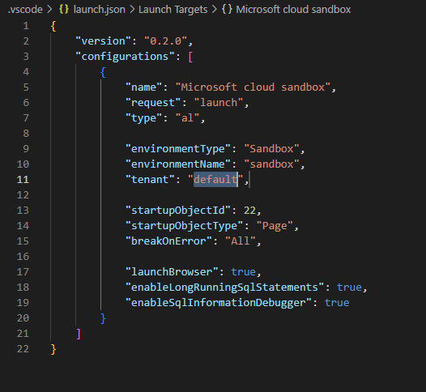
Connecting to An Environment
First, We Will Need to Connect to an Environment.
This is Configured in the Launch.json Page.
Let’s Break Up the Code and Add a Line to Choose the Right Environment to Develop Against.
Chunk the Code Together Like in this Example and Add the Words “tenant” after “environmentName”.

Slide 37
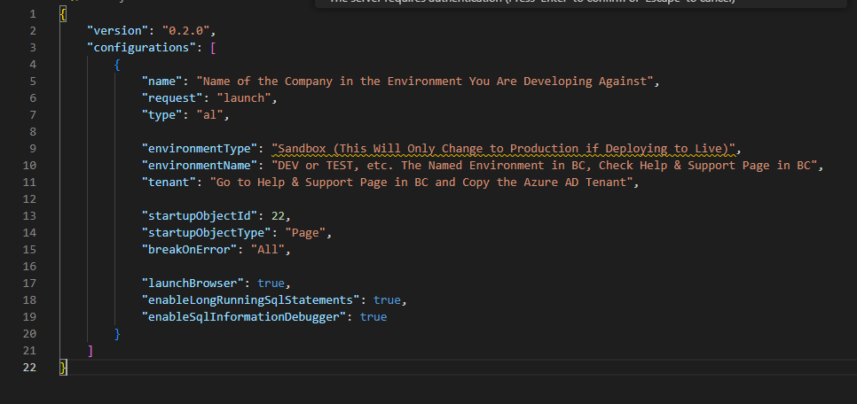
Connecting to An Environment
The Following Displays the Required Fields to Be Updated

Slide 38
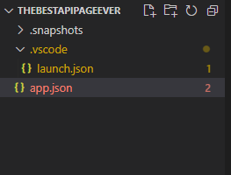
Connecting to An Environment
Click on the App.json file

Slide 39
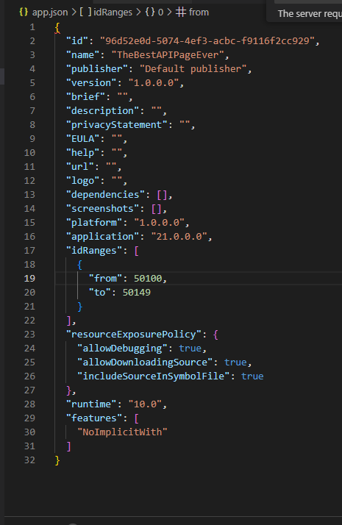
Creating the API/Connecting to An Environment
The App.json File Displays the Information of the Extension
This is Where Dependencies Can Be Defined if the API Extension Will Rely On It.
If We Chose to Move Forward with Development of an API at This Stage, Only Base Business Central Fields Will Be Retrieved
Notes:
Jamie

Slide 40
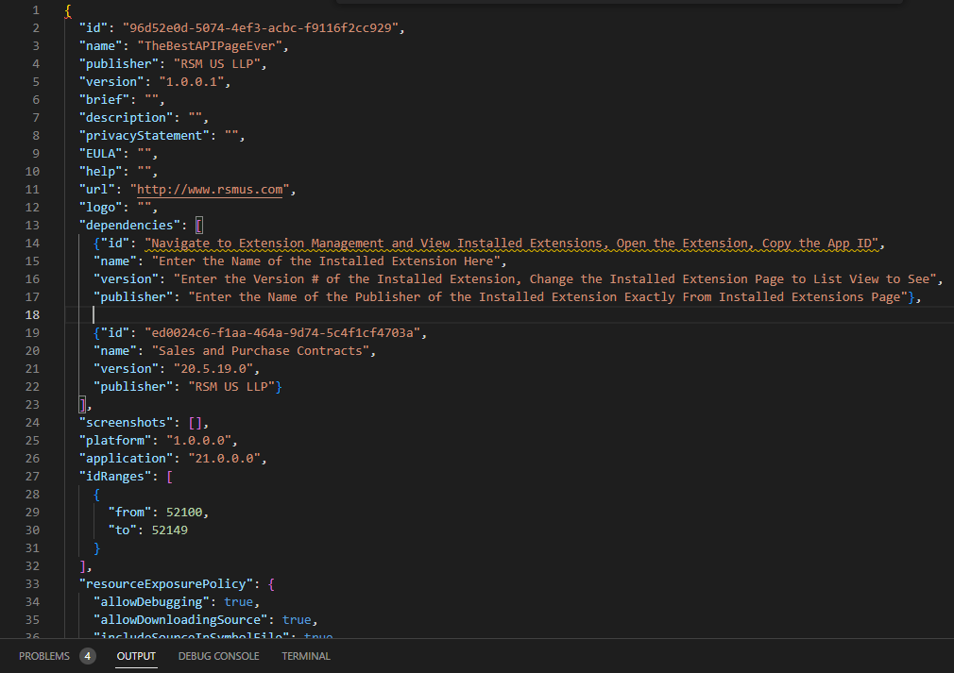
Creating the API/Connecting to An Environment
Here’s a screen shot of the following enhancements to a page.
Note: For best practice to not interfere with some Dev operations set the idRanges “from” 52100 “to” 52149. These ranges could change dependent on other extension deployments that claim those page ranges.
Notes:
Jamie

Slide 41
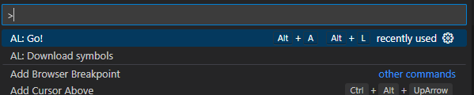
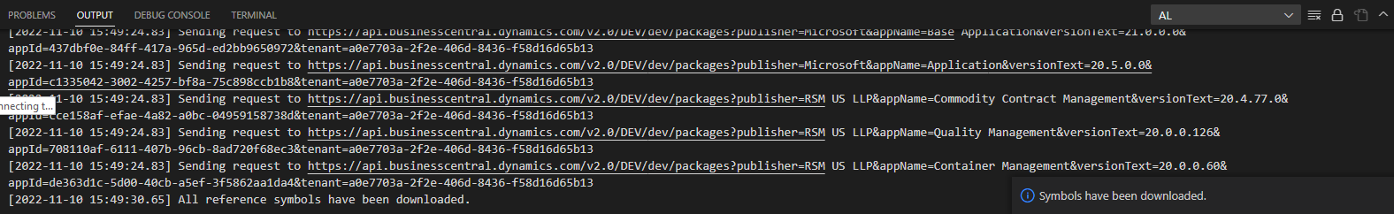
Creating the API/Connecting to An Environment
Now That Everything is Set, Time to Download Symbols. Open the Command Prompt (Ctrl+Shift+P) and Type in Download Symbols. Select the Command
VS Code Should Ask to Authenticate at This Point if it Has Not Done So Already. Enter in the Credentials for the Environment (i.e. UserNameHere@xxxxxxx.com) and go through the Authentication Prompt. The Output Screen Should Look Like This:
Notes:
Jamie

Slide 42
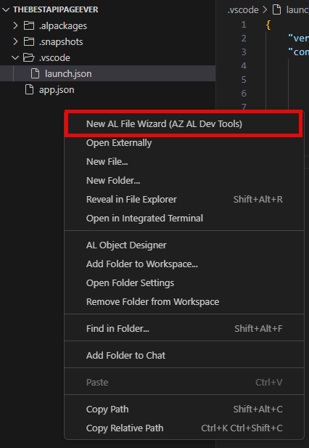
Creating the API
Once Symbols Are Downloaded and You Have Authenticated to the Environment, You Can Create the API Page.
First Right Click in the Explorer Section and Choose New AL File Wizard
Notes:
Jamie

Slide 43
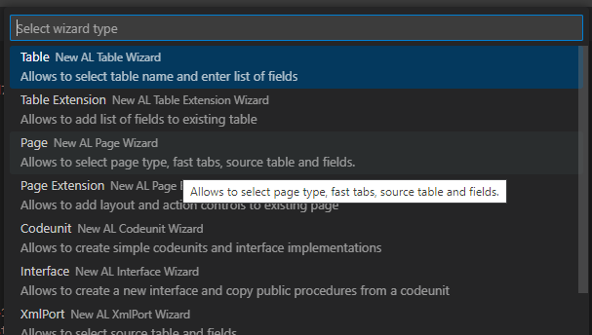
Creating the API
Select Page.
Notes:
Jamie

Slide 44
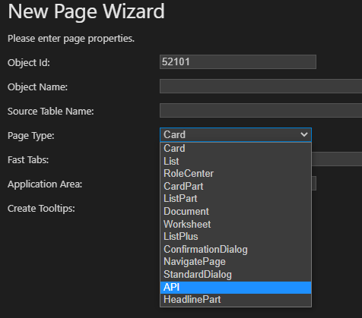
Creating the API
Select the Page Type First and Choose API
Notes:
Jamie

Slide 45
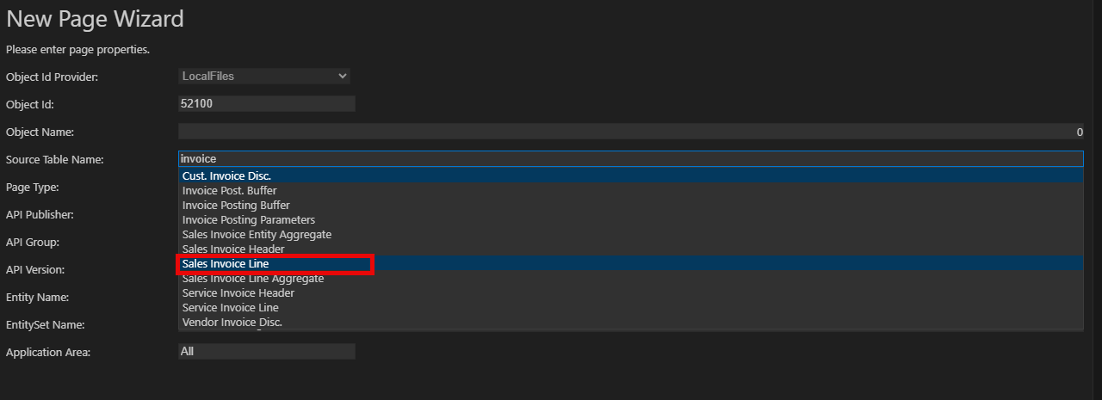
Creating the API
Choose the Source Table You Are Trying to Expose Data For By Entering in the Table Name
Notes:
Jamie

Slide 46
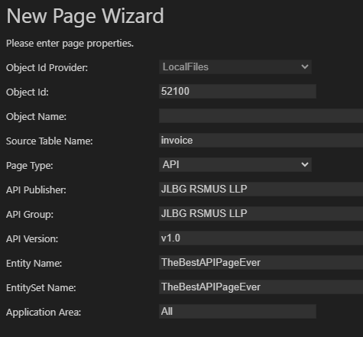
Creating the API
Fill Out the following:
API Publisher,
API Group, and
API Version
Exactly as Displayed.
The Entity Name and EntitySet Name Can Have No Spaces and Will Need to Be Named For What is Being Exposed
Notes:
Jamie

Slide 47
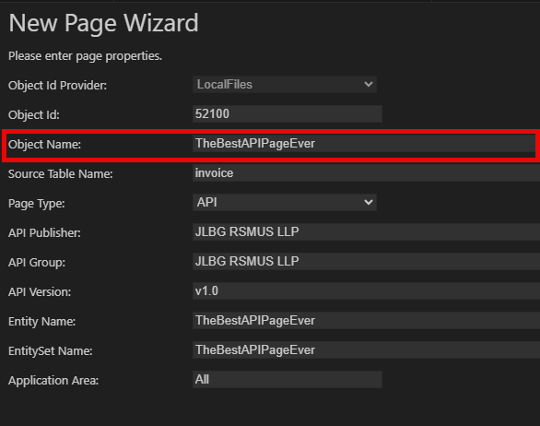
Creating the API
Ensure Your Object Name is Filled Out, Then Click Next
Notes:
Jamie

Slide 48
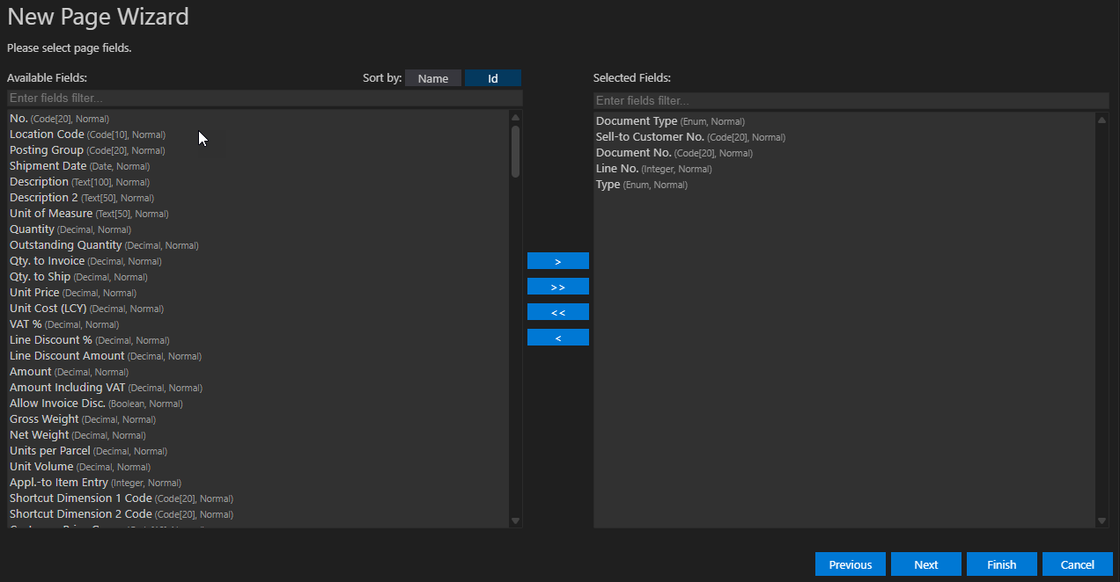
Creating the API
Now the Easy Part, Pick All the Fields You Want to Expose for Data Consumption.
Use the Middle Arrows to Add Selected Fields, Add All Fields, Remove All Fields, Remove Selected Fields.
**PRO TIP: Field order becomes even more critical when creating API pages. The order the fields are defined is this the order the fields are validated. If you get this wrong, your API consumers might run into confusing errors or unexpected behavior. Select Sort by: ID to Sort By ID to work with sequencing the structure of records to aid in validation.
Click Finish When Done Selecting
Notes:
Jamie

Slide 49
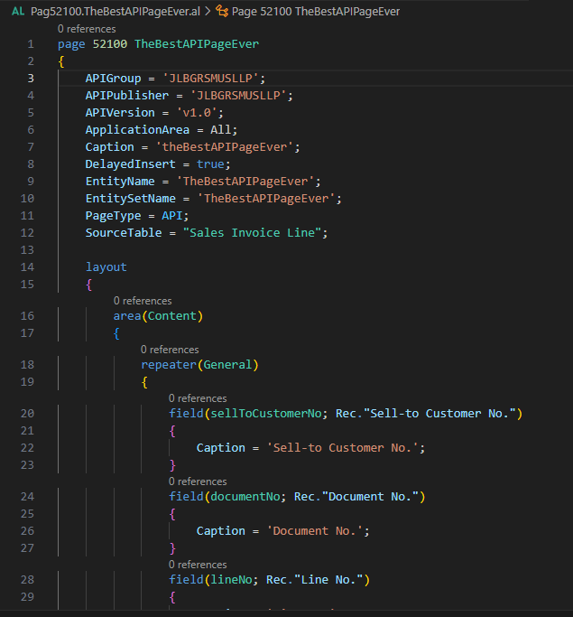
Creating the API
Like Emeril Legasse, BAM! You’ve Written a Bunch of Code.
Press the F5 Button to Publish Your Extension and It Will Install To the Environment Indicated on the Launch.json and App.json Files
Notes:
Jamie

Slide 50

Connecting with PowerBI
Now That the New API Has Been Published, Open PowerBI and Sign In Using the Same Login as the API Development. This Will Validate Credentials for PowerBI and Business Central
Notes:
Jamie

Slide 51

Connecting with PowerBI
Click on Get Data, Click on More…
Notes:
Jamie

Slide 52

Connecting with PowerBI
Click on Online Services, Click on Dynamics 365 Business Central, Click Connect
Notes:
Jamie

Slide 53

Connecting with PowerBI
You may have to sign in again to connect to Business Central data from PowerBI Desktop
Notes:
Jamie

Slide 54


Connecting with PowerBI
The Navigator Will Display the Different Environments Related to the Account.
Since We Published Our Connection to our development Environment, We Will Open that environment
Open the Company We Want to Test Against for Data.
Select the Advanced APIs folder path
Find the publisher path to find the API constructed.
Click the Checkbox Next To Your API and Choose Load.
Your Data Has Been Added to the Model
Notes:
Jamie

Slide 55

Create a Date Table

Slide 56
Create A Date Table
Date Table
DateTable = ADDCOLUMNS (
CALENDARAUTO(),
"Year", YEAR([Date]),
"Month Name", FORMAT([Date], "MMMM"),
"Month Number", MONTH([Date]),
"Quarter", "Q" & FORMAT([Date], "Q"))
Date Table Helps with Calculations and Filters
Month Number Helps with Display Sorting

Slide 57

Adding Measures

Slide 58
DAX Measure Samples
Selected Year Sales =
CALCULATE(
SUM(theBestAPIPageEver[amount]),
YEAR(theBestAPIPageEver[postingDate]) = SELECTEDVALUE(DateTable[Year])
)
Previous Year Sales =
CALCULATE(
SUM(theBestAPIPageEver[amount]),
SAMEPERIODLASTYEAR(DateTable[Date])
)

Slide 59

Selecting Visual Types
Bar and Line Chart
"Underwater Graph/Chart"
Slicer

Slide 60

Visualization

Slide 61
Key take-aways
Download VS Code and PowerBI
https://code.visualstudio.com/
https://www.microsoft.com/en-us/download/details.aspx?id=58494
Install Extensions (AZ Tools, etc.) in VS Code
Publish to Environment (F5)
Connect with PowerBI through Online Services, Select Business Central

Slide 62

Slide Deck & Code Repo
https://github.com/JeffLandeen/2025SummitNA_BCandPowerBI

Slide 63

Please fill out the session survey

Slide 64

FINANCE & SUPPLY CHAIN/F&O
Orlando, FL October 19-23, 2025

Slide 65

DYNAMICS 365 CUSTOMER ENGAGEMENT CRM
Orlando, FL October 19-23, 2025

Slide 66

POWER PLATFORM
Orlando, FL October 19-23, 2025

Slide 67

DYNAMICS GP
Orlando, FL October 19-23, 2025

Slide 68

FABRIC
Orlando, FL October 19-23, 2025

Slide 69

AGENTS & COPILOT
Orlando, FL October 19-23, 2025

Slide 70

M365/MODERN WORK
Orlando, FL October 19-23, 2025

Slide 71
Session Title

Slide 72
Session Title

Slide 74


Speaker Name
<title>
<company>
<BCUG/NAVUG volunteer positions>
Speaker Name
<title>
<company>
<BCUG/NAVUG volunteer positions>
Speaker Name
<title>
<company>
<BCUG/NAVUG volunteer positions>

Slide 76
Session Agenda
Based on your session objectives, insert an Agenda here to give your audience a frame of reference of the flow of your session.
Section break slides can be used between agenda points.

Slide 77
Session Objectives
What will you learn today?
Learning objective number 1 (required)
Learning objective number 2 (optional)
Learning objective number 3 (optional)

Slide 78
Section Title

Slide 81
Key take-aways
This slide is for you to list for you audience:
Key learnings from your session (tied back to the session description and key objectives)
Key actions they should take when back in their office

Slide 82
Suggested Resources
This slide is for you to list for you audience:
Other related sessions at Summit
Helpful websites and blogs
Reference materials

Slide 83
Thank you for attending!

Slide 85
DYNAMICS 365 BUSINESS CENTRAL (NAV)
© 2025 Dynamic Communities. All rights reserved.

Slide 86
FINANCE & SUPPLY CHAIN/F&O
© 2025 Dynamic Communities. All rights reserved.

Slide 87
DYNAMICS 365 CUSTOMER ENGAGEMENT CRM
© 2025 Dynamic Communities. All rights reserved.

Slide 88
POWER PLATFORM
© 2025 Dynamic Communities. All rights reserved.

Slide 89
DYNAMICS GP
© 2025 Dynamic Communities. All rights reserved.

Slide 90
FABRIC
© 2025 Dynamic Communities. All rights reserved.

Slide 91
AGENTS & COPILOT
© 2025 Dynamic Communities. All rights reserved.

Slide 92
M365/MODERN WORK
© 2025 Dynamic Communities. All rights reserved.

Slide 93
© 2025 Dynamic Communities. All rights reserved.

